Slide 1
MATrix LABoratory

Slide 2
Introduction
MATLAB – MATrix LABoratory
  It was later marketed and further developed under MathWorks Inc. (founded in 1984) – www.mathworks.com
  Matlab is a software package which can be used to perform analysis and solve mathematical and engineering problems.
  It has excellent programming features and graphics capability – easy to learn and flexible.

Slide 3
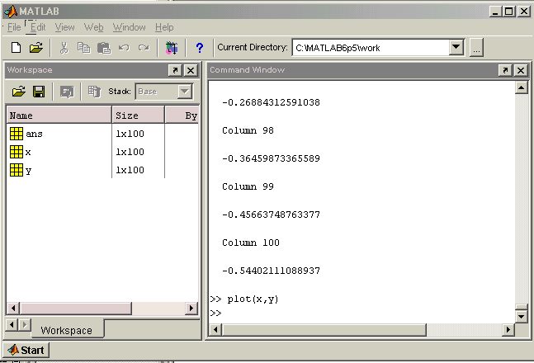
Environment Setup
Installation and Workspace

Slide 4
Syntax
Variable Naming
  Although variable names can be of any length, MATLAB uses only the first N characters of the name, (where N is the number returned by the function namelengthmax), and ignores the rest. Hence, it is important to make each variable name unique in the first N characters to enable MATLAB to distinguish variables.
Semicolon
  if you end the line with a semicolon, MATLAB performs the computation but does not display any output.

Slide 5
Variables
Vectors
Row and Columns
Matricies

Slide 6
Commands
Commandline Commands
Help Files
        help()
        lookfor()
Module Commands

Slide 7

Commands

Slide 8
Class 2

Slide 9
M-Files
Scripts
  When you invoke a script, MATLAB simply executes the commands found in the file. Scripts can operate on existing data in the workspace, or they can create new data on which to operate.
Functions
  An anonymous function is a simple form of the MATLAB function that is defined within a single MATLAB statement.
    sqr = @(x) x.^2;
    a = sqr(5)
    A private function is a type of primary function. Its unique characteristic is that it is visible only to a limited group of other functions.
    Any function that is not anonymous must be defined within a file. Each such function file contains a required primary function that appears first, and any number of subfunctions that can follow the primary.

Slide 10
Data Types
Int8
Single
Double
Logical
Cell Arrays
Structure
Data Type Conversion

Slide 11
Operators
Arithmetic
Relational
Logical
Bitwise
Set

Slide 12
Decisions
if.. end
if else .. end
Nested if
Switch

Slide 13
Loops
While
    while x< 10 (condition)
    action
    end
For
    for n=0:10 x(n+1) = sin(pi*n/10); end
Nested For
    for i = 1:m for j = 1:n H(i,j) = 1/(i+j); end end
      Break
  The break statement lets you exit early from a for loop or while loop. In nested loops, break exits from the innermost loop only
Continue
  The continue statement passes control to the next iteration of the for loop or while loop in which it appears, skipping any remaining statements in the body of the loop.

Slide 14
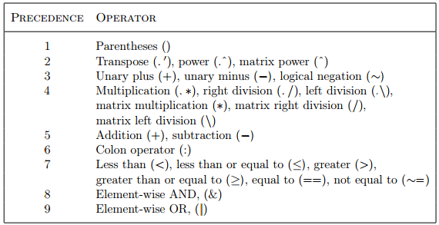
Operator Precedence
The precedence rules for MATLAB are shown in this list
  Ordered from highest (1) to lowest (9) precedence level.
  Operators are evaluated from left to right.

Slide 15
Vectors
Row
Columns
Vector Operations

Slide 16
Matrix
Matrix Operations

Slide 17
Arrays
Special Arrays:
Zeros()
Ones()
eye()
rand()
cell()

Slide 18
Colon Notation
One way to make your MATLAB programs run faster is to vectorize the algorithms you use in constructing the programs
    x = .01;
    for k = 1:1001
    y(k) = log10(x); x = .01:.01:10; y = log10(x);
    x = x + .01;
    end
1:10

Slide 19
Numbers
single()
double()
int8(), int16(), int32() and Int64()

Slide 20
Strings
Joining Strings: strjoin()
Replace Strings: strrep()

Slide 21
Functions
Anonymous Functions
Nested Functions
Private Functions

Slide 22
Data Import
importdata(filename, delimiter, HeaderLine)
low-level File I/O

Slide 23
Data Output
save() with Filename -ascii format
dlmwrite ()
using diary()
file operations

Slide 24
Advanced Topics
Graphics
Algebra
Calculus
  Limits
      >> syms x;
      >> limit(sin(x)/x,x,0)
      ans = 1
  Differential
      >> syms x;
      > > diff(x^3)
      ans = 3*x^2
  Integration
      >> syms x;
      > > int(x^2)
      ans = 1/3*x^3

Slide 25
Class 3 - Simulink

Slide 26
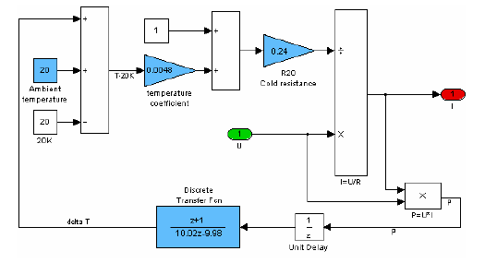
Simulink

Slide 27
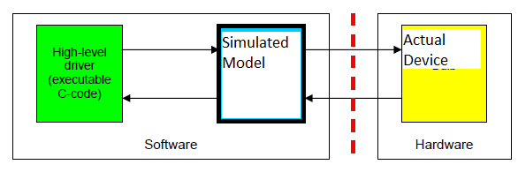
HIL

Slide 28
References
http://www.serc.iisc.ernet.in/facilities/ComputingFacilities/software/getstart.pdf
http://www.mathworks.com/examples/simulink/category/automotive-applications

